Slide 1
William D. Nordhaus:
Do Real-Output and Real-Wage Measures Capture Reality? The History of Lighting Suggests Not
J. Bradford DeLong
https://www.icloud.com/keynote/0dc5gmnPPBwdqXx-Ql3i-hEaQ

Slide 2
Bill Nordhaus: History of Lighting
William D. Nordhaus. 1997. “Do Real-Output and Real-Wage Measures Capture Reality? The History of Lighting Suggests Not.” In The Economics of New Goods, edited by Timothy F. Bresnahan and Robert J. Gordon. Chicago: University of Chicago Press for NBER, pp. 29– 66. http://www.nber.org/chapters/c6064 | <http://tinyurl.com/dl2017201a>

Slide 3
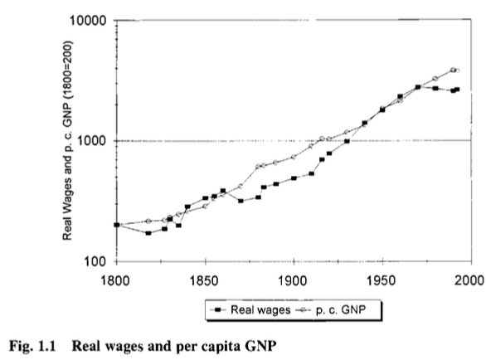
Bill Nordhaus: Measured Real Productivity
William D. Nordhaus. 1997. “Do Real-Output and Real-Wage Measures Capture Reality? The History of Lighting Suggests Not.” In The Economics of New Goods, edited by Timothy F. Bresnahan and Robert J. Gordon. Chicago: University of Chicago Press for NBER, pp. 29– 66. http://www.nber.org/chapters/c6064
Conventional measures: a 15-fold increase in real first-world GDP/capita and productivity

Slide 4

Bill Nordhaus: Rocket Ship to the Singularity?
A 20-fold or a 30,000-fold increase in real wages in the North Atlantic since 1800?
Nordhaus calculates that—back in 1991—28% of consumption was “run-of-the-mill”, 36% had been “seismically-active” since 1800, and 37% was in sectors that had no effective affordable equivalent in 1800
Dixit-Stiglitz tells us that we multiply “ordinary” utilities by the number of varieties. Which way does that mislead us?

Slide 5
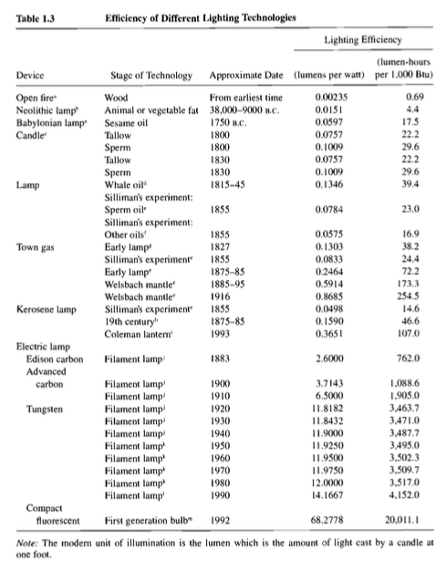
Bill Nordhaus: Rocket Ship to the Singularity II
A 5000-fold decrease in the price of light since 1800
This is something that churned up between 1% and 5% of household budgets back in 1800
100-fold CPI bias in the price of light since 1800

Slide 6
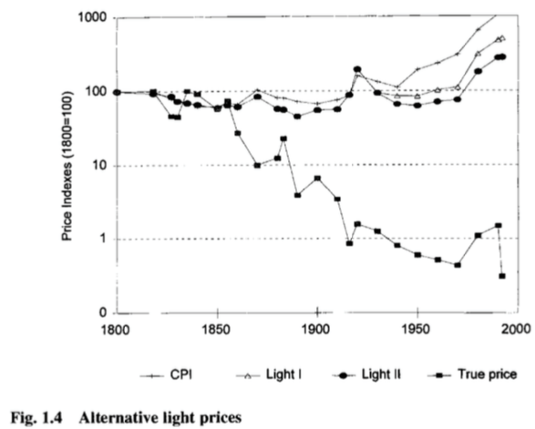
Bill Nordhaus: Rocket Ship to the Singularity III
A 5000-fold decrease in the price of light since 1800
This is something that churned up between 1% and 5% of household budgets back in 1800
100-fold CPI bias in the price of light since 1800

Slide 7

“Do You Like Music?”
Perhaps a better way than doing math in which to grasp the magnitude of the contribution that the changing set and mass of goods and services we can produce makes to our wealth is by reading Looking Backward, Edward Bellamy’s 1887 utopian novel. In Looking Backward the narrator—thrown forward in time from 1895 to 2000 by an unbelievable and crude plot device.
He hears the question (p. 87): “Are you fond of music?”
He expects his hostess to play the piano—a social accomplishment of upper-class women around 1900. To listen to music on demand then, you had to have—in your house or nearby—an instrument, and someone trained to play it. It would have cost the average worker some 2400 hours, roughly a year at a 50-hour workweek, to earn the money to buy a high-quality piano, and then there would be the expense and the time committed to piano lessons.
But today, to listen to music-on-demand in your home, all you need is… your smartphone…

Slide 8

Labor-Time Values
The labor-time value of a Steinway piano has fallen in price from 2400 average worker-hours a century ago to 1100 average worker-hours today. But if what you value is not the piano itself but the capability of listening to music at home, the cost has fallen from 2400 average worker-hours a century ago to… what?
Maybe 10 hours?
So when we calculate the increase in material wealth, do we count the halving of the labor-time price of the commodity (which is what Historical Statistics does); or do we count the 240-fold decrease in the real labor-time price of the capability of listening to piano music? The experiences of live and recorded music are different in kind. But are they different enough to put a serious dent in the fact that a household today can acquire the capability of listening to piano music for only 1/240 the labor time cost of a household of a century ago? And whose piano playing do you really want to listen to?

Slide 9
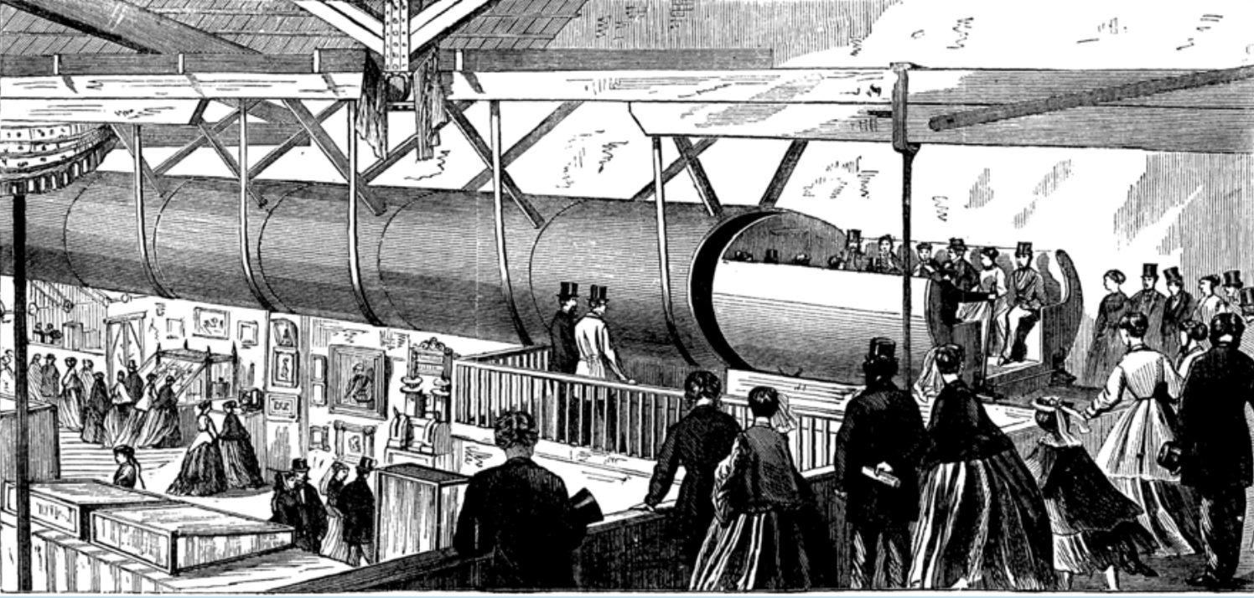
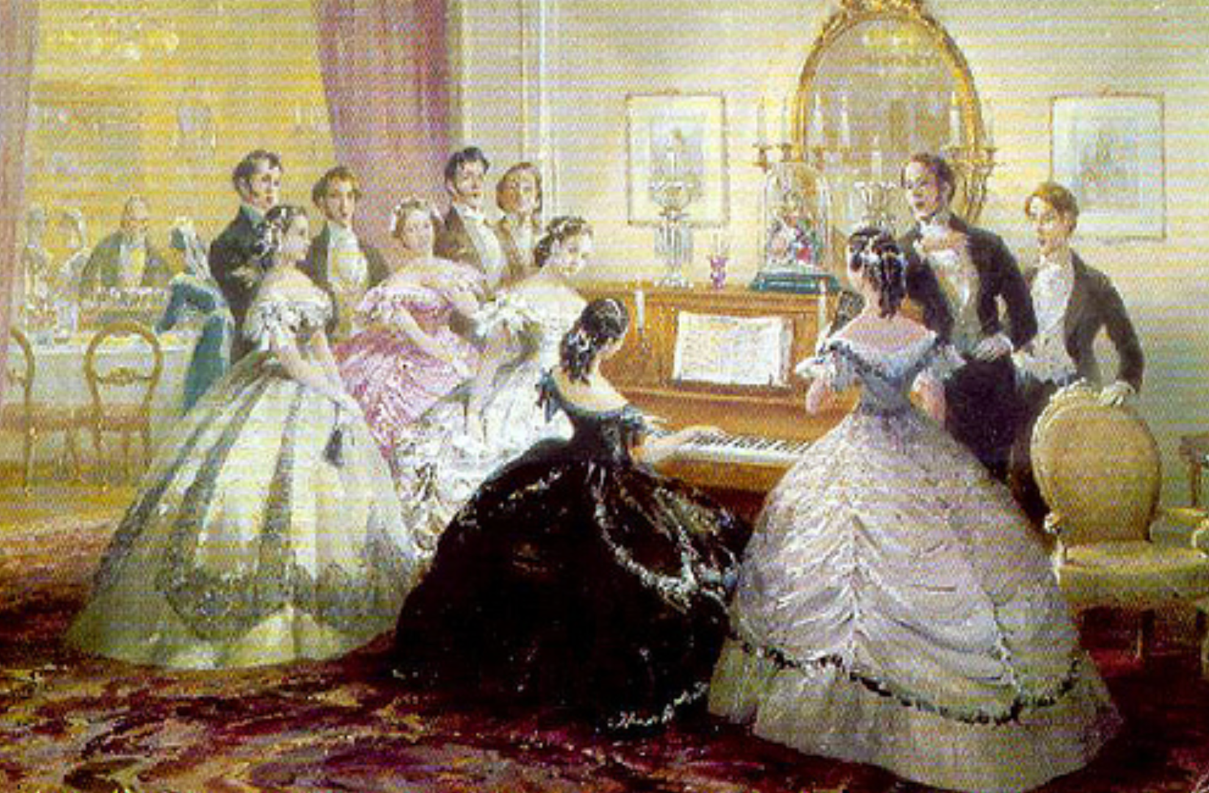
“The Limit of Human Felicity…”
After answering “yes” to the question “would you like to hear some music?” Bellamy’s protagonist is stupefied to find his hostess “merely touched one or two screws… and immediately the room was 'filled with music; filled, not flooded, for, by some means, the volume of melody had been perfectly graduated to the size of the apartment. “Grand!” I cried. ‘Bach must be at the keys of that organ; but where is the organ?’ (pp. 88-89) He learns that his hostess has called the orchestra on the telephone—for in Bellamy's utopia you can dial one of four orchestras, and then put it on the speakerphone.
Bellamy’s protagonist then says (p. 90): “If we [in the nineteenth century] could have devised an arrangement for providing everybody with music in their homes, perfect in quality, unlimited in quantity, suited to every mood, and beginning and ceasing at will, we should have considered the limit of human felicity already attained…"
To Edward Bellamy—a self-described utopian visionary, a late-nineteenth century minister’s son from western Massachusetts—a radio that could tune into any of four stations is “the limit of human felicity.”

Slide 10

Tower Records
What if someone were to take Edward Bellamy to Tower Records?
Ooops.
There is no Tower Records anymore, because they have been and are being eliminated by alternative and even cheaper and more efficient systems of distribution.
Well, if we could have taken Edward Bellamy to Tower Records when it existed, his heart would have stopped. Yet we do not think of our modern ability to cheaply listen to high-fidelity go-anywhere listen-to-anything music as a remarkable or even a notable part of our economy. We do not daily give thanks for our CD collections and genuflect in front of our iPods. We in the North Atlantic today do not reflect that we have been brought to “the limit of human felicity…”
But Edward Bellamy would think that we have…

Slide 11

Nordhaus, and Not Quite Among the 400
The argument that our commodity-focused price indices miss most of the real action—that price indices focusing on the services provided would produce vastly greater estimates of long-run economic growth—is made most powerfully by William Nordhaus (1996) in his study of the economic cost of light.
Nordhaus attempts to construct a consistent series of the real labor-time cost of illumination from the dawn of civilization until today. He concludes that the past hundred years have seen a ten thousand-fold decline in the real price of illumination. Yet the commodity-based price indices economists rely on have only captured a ten-fold decline in this real price. Nordhaus guesses that standard estimates understate “true” economic growth since 1800 by between 0.5% and 1.4% per year—an amount that cumulates to a multiplicative factor of between 3 and 15 over the past to centuries, and to a conclusion that real wages since 1900 have multiplied by a factor between 20 and 100.
Is this credible?
I have no problem at all with Nordhaus’s conclusion. My family’s income today is roughly $400,000 a year—about eight times median earnings per worker. Suppose that you stuffed me and my family into a time machine, sent us back a century to 1890, and then gave us an income equal to sixty-four times that of 1890 median per worker. We would not be among the 400 invited to the most exclusive parties in the mansions of Newport Rhode Island; but we would be among the next outer circle of 2,000 or so.
Would we then feel as rich as we feel now? Would we be happy—or at least not unhappy—with the switch?

Slide 12
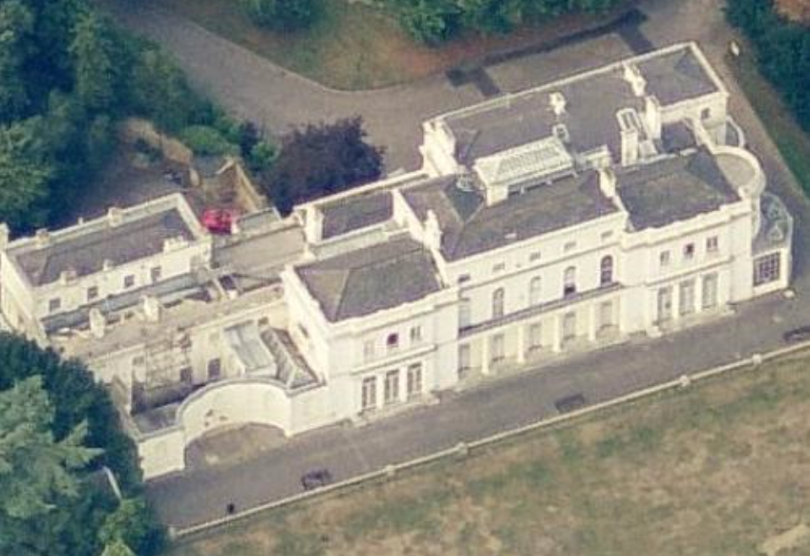

The Death of Nathan Meyer Rothschild
Our power to purchase some commodities would be vastly increased: we would have at least three live-in servants, a fifteen-room house (plus a summer place), if we lived in San Francisco we would live on Nob Hill, if we lived in Boston we would live on Beacon Hill, if we lived in New York we would live on Park or Fifth Avenue.
The answer is surely that we would not be happy and we would feel poor (although if you compared yourself to other people in 1890, you would feel very rich). I would want, first, health insurance: the ability to go to the doctor and be treated with late-twentieth-century medicines. Franklin Delano Roosevelt was crippled by polio. Nathan Meyer Rothschild—the richest man in the world in the first half of the nineteenth century—died of an infected abscess in his mid-fifties and never saw his grandchildren grow up. Without antibiotic and adrenaline shots I would now be dead of childhood pneumonia.

Slide 13
The Death of Nathan Meyer Rothschild
The second thing I would want would be utility hookups: electricity and gas, central heating, and consumer appliances. The third thing I would want to buy is access to information: audio and video broadcasts, recorded music, computing power, and access to databases.
None of these were available at any price back in 1890.
I could substitute other purchases for some. I could not buy a washing machine, but I could (and would) hire a live-in laundress to do the household's washing—if I were rich enough. I could not buy airplane tickets; I could make sure that when I did travel by long distance train and boat I could do so first class, so that even though travel churned up enormous amounts of time it would be time spent relatively pleasantly. But I could do nothing for medical care: no matter how rich I was, I would be poor. And I could do little or nothing for access to information, communications, and entertainment technology save to spend the equivalent of $1000 on books I can now buy for $30, and to leave the children home with the servants and go to the opera and the theater every other week: no matter how rich I was, I would be poor. (Surely you could have hired musicians to play for you?)

Slide 14
Nordhaus: History of Lighting: Catch Our Breath…
Ask a couple of questions?
Make a couple of comments?
Any more readings to recommend?
<https://www.icloud.com/keynote/0dc5gmnPPBwdqXx-Ql3i-hEaQ>

